Slide 1


Rutgers Data Science Bootcamp
Project 1 – Historical NBA Analysis
Jul 22, 2021

Slide 2
Project Overview
by Kate

Slide 3

Presented by: “The Winning Factors”
Kate Yayla @kate_yayla
Dennis
Smith
@DennisPSmith5676
Bryant
Mondragon
@MondragB
Jay
Dhruv
@jaybdhruv
Samuel
Schappel
@sammyschapps87

Slide 4

Project Sources
In this project, we analyzed the NBA history with the parameters of players age, the winning percentage of teams, PER (players efficiency rating), minutes played between 1986-2017 and used Python jupyter notebook for creating codes. We used data from 2 main sources:
https://www.kaggle.com/drgilermo/nba-players-stats?select=Seasons_Stats.csv
https://data.world/gmoney/nba-team-records-by-year/workspace/file?filename=Historical+NBA+Performance.xlsx
Additional Sources referenced
https://www.sportsgamblingpodcast.com/2020/04/20/nba-most-valuable-statistic/
https://pypi.org/project/nba-api/
We combined these lists to get information needed about the Teams and Players
We compared how these attributes (see Questions slide) influence winning in the NBA.

Slide 5
Project Questions
Can the Team Four Factor Rating of Basketball help in accurately determining the team’s winning percentage? Does the dataset that we are using needs to be adjusted for accurate analysis?
How does age of the player affect PER (Player Efficiency Rating)?
How does a player’s move (Top 10 players only based on overall points) affect the new team’s winning percentage?
Is the Minutes Played variable positively correlated with a player's core performance variables? (i.e.: 3pts, 2pts, blocks, steals, etc.)
Q1
Q1
Q2
Q2
Q3
Q3
Q4

Slide 6

Parameters
Parameters | Against
Effective Field Goal Turnover Rate Offensive Rebounds Free Throw Rate Team Four Factor Rating = 40% Effective Field Goal - 25% Turnover Rate % + 20% Offensive Rebounds + 15% Free Throw Rate | Team’s Winning Percentage
Age | PER(Player Efficiency Rating)
Player’s Move from one team to other | New team’s winning percentage
Minutes Played | 3pts, 2pt, Stl, Blk, Drb, Orb, Ft

Slide 7










Sources
Tools

Slide 8
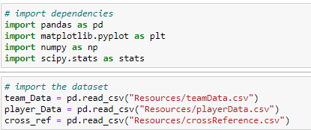
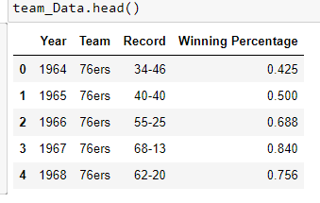
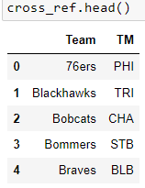
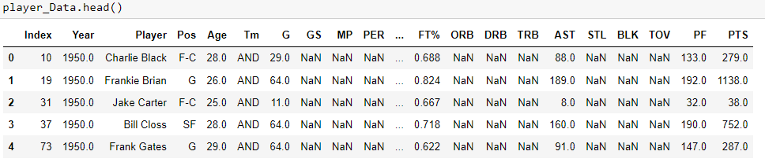
Data Cleanup
Code to import dataset and merged csv files, data cleaning

Slide 9
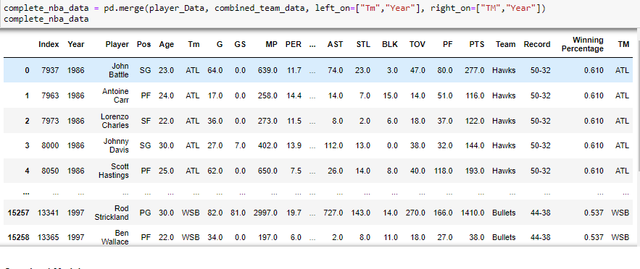
Data Cleanup
Final dataset

Slide 10
Four Factors Rating
by Jay
Can the Team Four Factor Rating of Basketball help in accurately determining the team’s winning percentage? Does the dataset that we are using needs to be adjusted for accurate analysis?

Slide 11

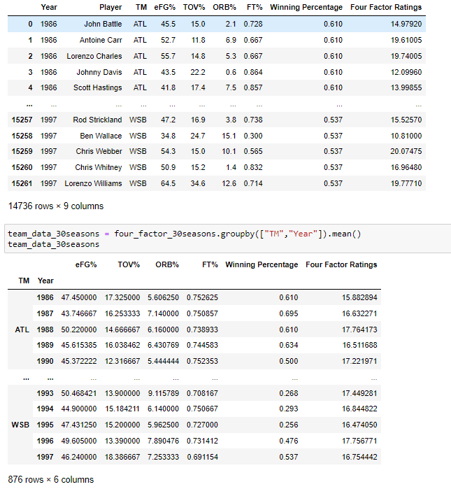
Create Data Set for Four Factors Ratings
Code to four factors ratings and limit the data between 1986 to 2017

Slide 12
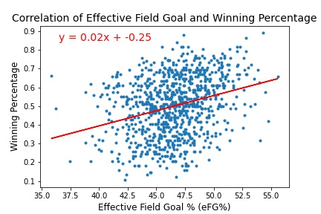
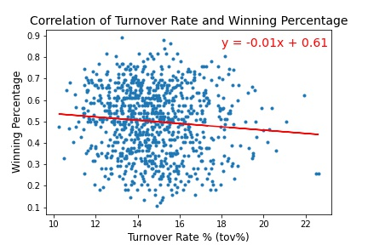
Scatter Plot and Linear Regression for individual factors and winning percentage

Slide 13

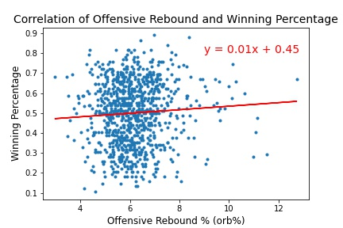
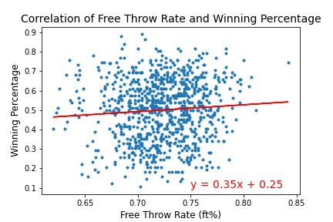
Scatter Plot and Linear Regression for individual factors and winning percentage

Slide 14
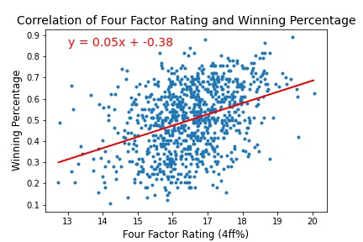
Analysis for “Four Factor Rating” vs Team’s Win
From Scatter Plot and Linear Regression analysis, we can observe that Four Factor Rating has a better correlation to the team’s winning percentage than the individual factors.
The value of r is 0.377 in this case which indicates that there is a weak positive correlation between Four Factor Rating and Team’s Winning Percentage. This indicates that Four Factor Rating is not an efficient parameter in determining the winning percentage of the team. There are several other external factors that needs to be considered to accurately predict the winning percentage.

Slide 15
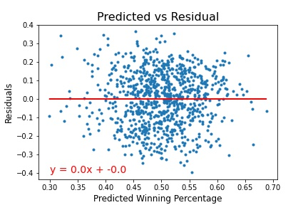
Do we need to adjust our dataset for accurate analysis?
Residuals = Observed – Predicted
Residuals are essentially errors in our predictions. A positive residual indicates that our prediction was lower than expected while negative residual indicates that our prediction was higher than expected.
From this Scatter plot, we can see that slope is 0 and linear regression is a horizontal line. This means that there is no correlation in the predicted values and residuals. The occurrences or residuals are in a randomized order. This concludes that the dataset that we were using is an accurate dataset and doesn’t require adjustments.

Slide 16
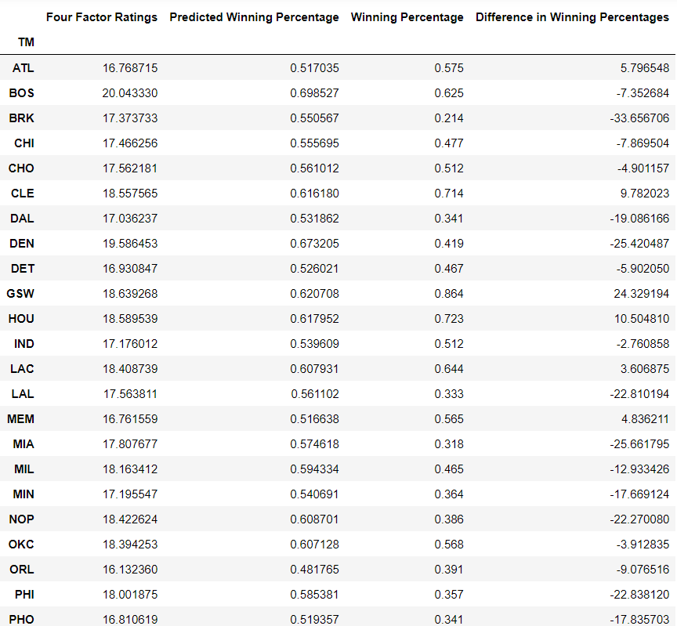
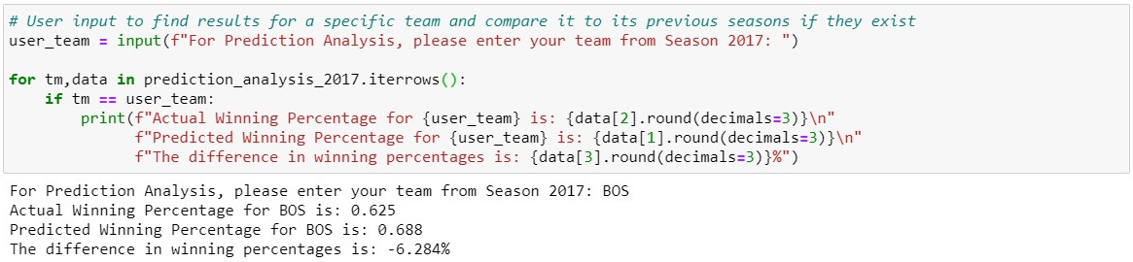
Actual & Predicted values based on user input for 2017

Slide 17
Player’s Age
by Bryant
How does age of the player affect PER (Player Efficiency Rating)?

Slide 18

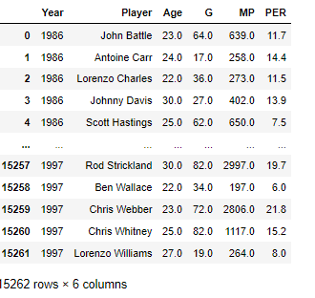
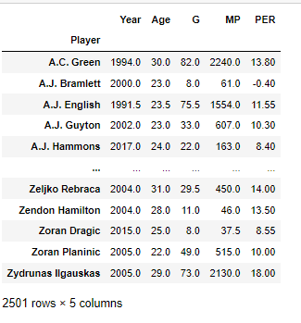
Create Data Set for Player’s Age
Code to four factors formula and limit the based-on median
Age Player Data
Median Player

Slide 19
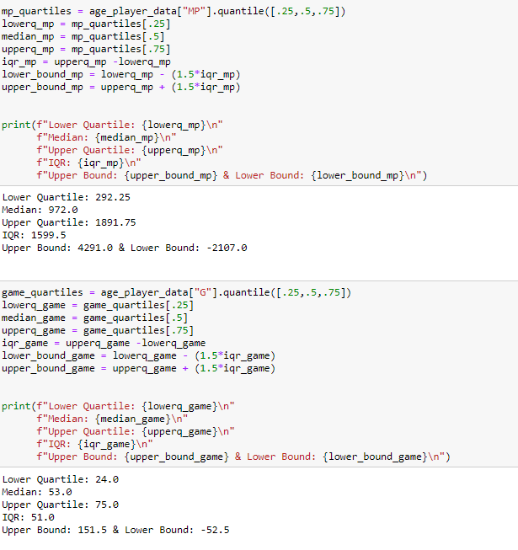
Quartiles based on MP and G

Slide 20
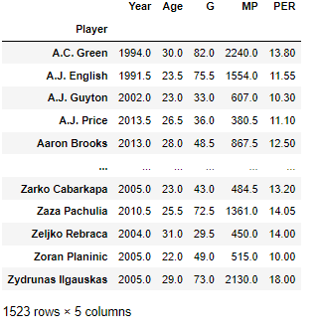
Top Players using quartiles range

Slide 21
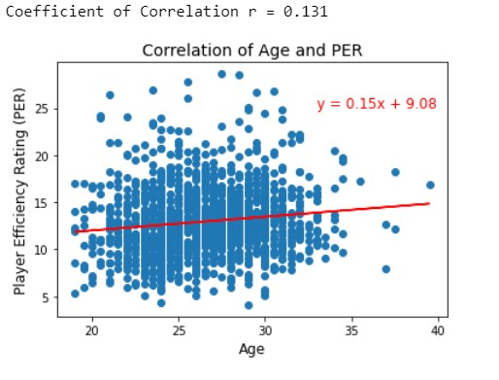
Analysis for “Player’s Age” vs PER
From this scatter plot and the value of r, we can conclude that there is a very weak positive correlation between Age and PER. This is not a sufficient data to predict that age of the player affects his PER.
But we can see it here that more datapoints are recorded between the age 20 and 30 and a very few datapoints are recorded after the age of 30. This also infers that a player’s PER will reach a peak between these years.

Slide 22
Player’s Move
by Dennis
How does a player’s move (Top 10 only based on overall points) affect the new team’s winning percentage?

Slide 23
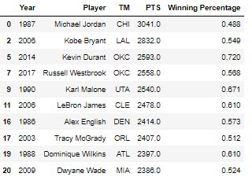
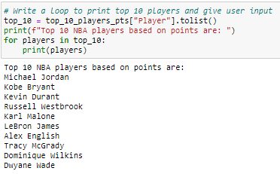
Create Data Set for Player’s Move
Code to create data set and find top 10 players
Top 10 Players

Slide 24


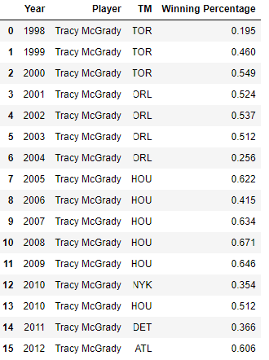
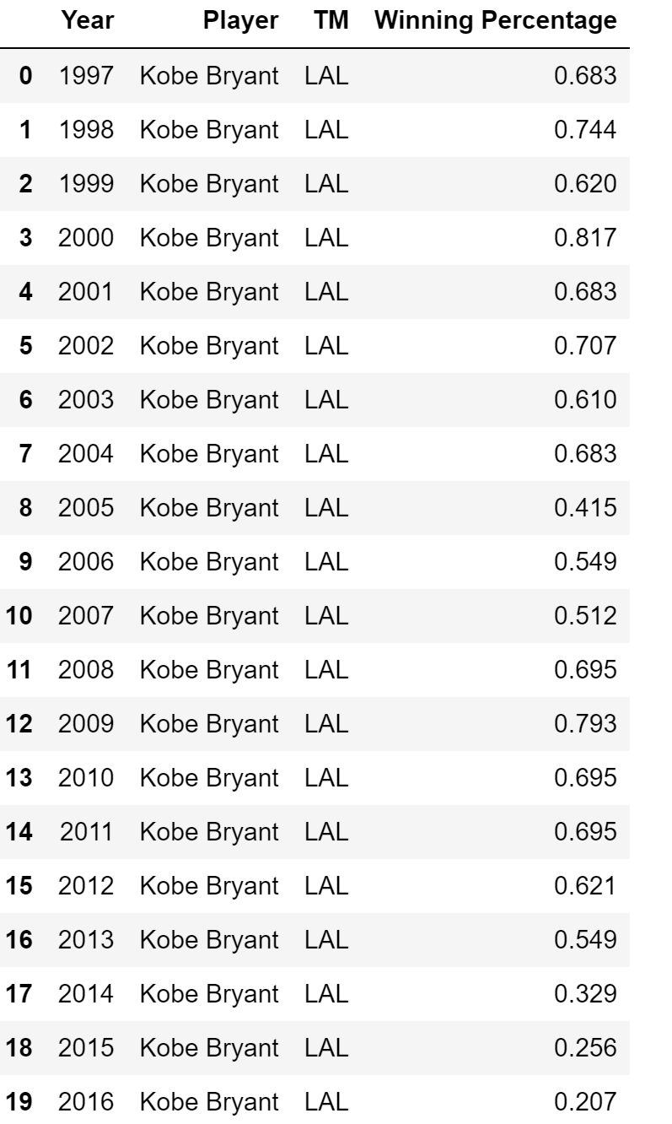
Create Data Set for Player’s Move
Code to sort by user input
If user input “Tracy McGrady”
If user input “Kobe Bryant”

Slide 25
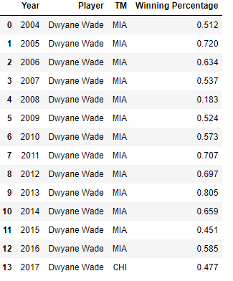
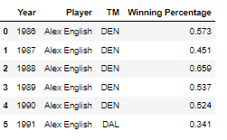
Create Data Set for Player’s Move
If user input “Dwyane Wade”
If user input “Alex English”

Slide 26
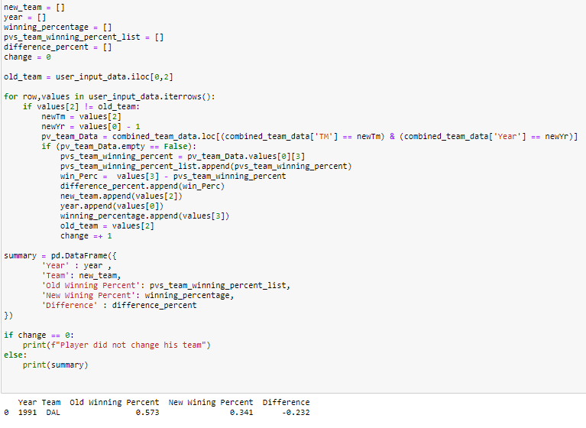
Code for finding new team’s winning percentage
Code to find out players move impact on new team winning percentage

Slide 27
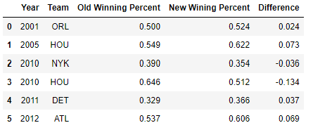


Analysis for “Player’s Move” vs Winning percentage
According to the difference between old winning percentage and new team winning percentage, we can say there is a positive relation.
“Dewyane Wade”
“Tracy McGrady”
“Alex English”
“Kobe Bryant”
Player did not change his team

Slide 28
Player’s Performance
by Sam
Is the Minutes Played variable positively correlated with a players core performance variables? (i.e: 3pts, 2pts, blocks, steals, etc.)

Slide 29
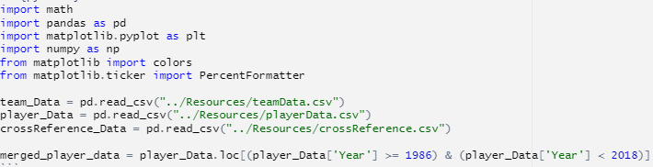
Create Dataset including Necessary Variables
Code to import dependencies, data and to merged data
Code to create subset data including variables minutes played, three pointers, two pointers, free throws, offensive rebounds, defensive rebounds, and steals.

Slide 30
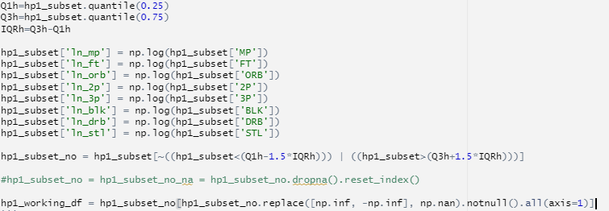
Create IQR to get rid of outliers and take the natural log of variables chosen
I take the natural log of my variables in order to change my regression from a unit change to a percent change. This is will be considered an elasticity. I then got rid of all rows containing Inf or Nan values as a result of this transformation.

Slide 31
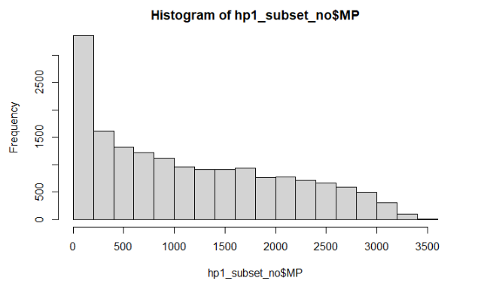
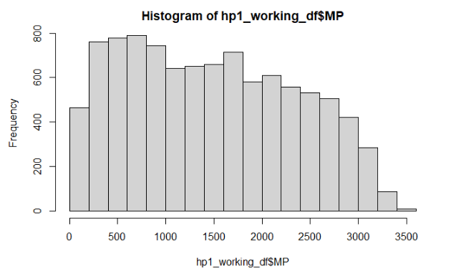
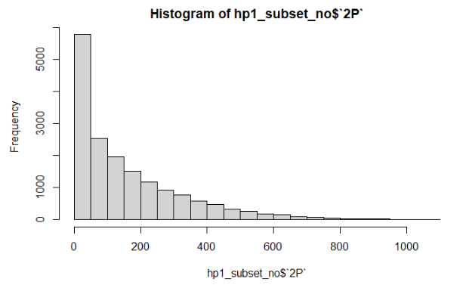
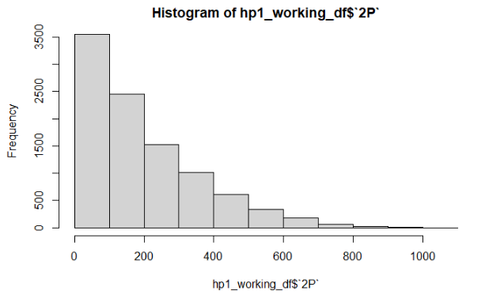
Visualization of Raw to Outlier Data Set
Raw data
Data with no outliers

Slide 32
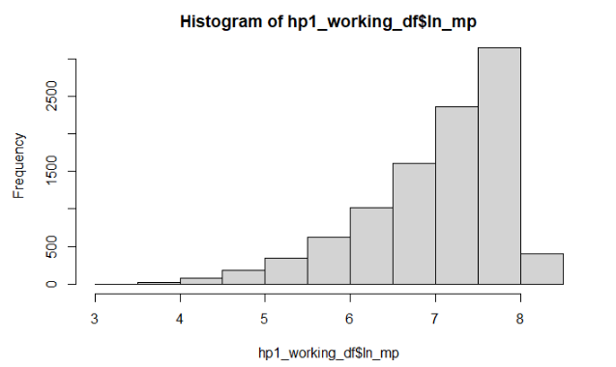
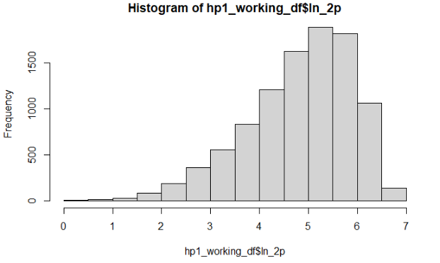
Visualization of Untransformed Variable to Transformed Variable

Slide 33

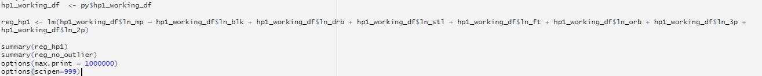
Regression Analysis
Hypothesis
On average, minutes played is positively correlated to a player's three-point score, two-point score, free throw score, offensive rebound score, defensive rebound score, block score, and steal score. The more minutes you play the more chances you have to either score a point or prevent the other team from scoring a point.
Import reticulate to talk between python and R
Code to Run Regression
Regression equation
Y = -0.03(ln_blk) + 0.36(ln_drb) + 0.25(ln_stl) + 0.01(ln_ft) - 0.03(ln_orb) + 0.06(ln_3p) + 0.26(ln_2p) + 3.08

Slide 34
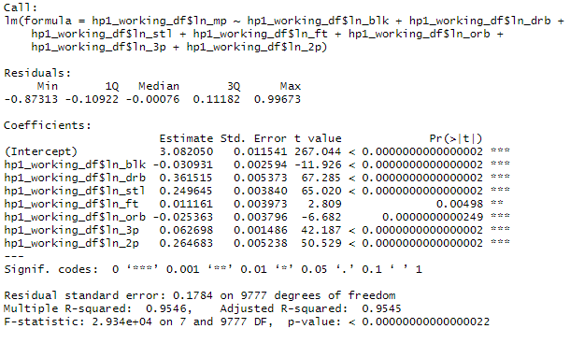
Regression Analysis
Regression Analysis
After close analysis of this regression, I am able to confirm that all of the variables I have chosen are positively correlated except for blocking stats and offensive rebounds. Since all of these variables are log transformed, I am now looking at the elasticity between variables. I am able to tell that a ten percent increase in minutes played results in a 0.3% decrease in a player's blocking stats. Even though this is a negative correlation, It has a very small correlation which tells me that even though this is statistically significant (low p value) minutes played does not affect a player's blocking stats in a largely impactful way. The other negative coefficient is similar in that minutes played has a very small impact on it. For a ten percent increase in minutes played, a player's offensive rebounds decrease by 0.2%. The independent variables with the strongest correlation to minutes played are defensive rebounds, steals, and two-point shots. Respectively, a ten percent increase in minutes played yields a 3.6% increase in defensive rebounds, a 2.5% increase in steals and a 2.6% increase in 2 pointers.

Slide 35
Final Thoughts and Insights
My insight as to why these are more highly correlated is that these aspects of a basketball game are more likely to happen than the negatively correlated aspects. For example, a defensive rebound is much more likely to occur vs an offensive rebound since when a team is on defense, they usually have more players under the basket than the opposing team. Similarly, blocking a shot in the NBA is considered very hard to do which makes sense as to why on average, the more a person plays the less blocked shots he has. The R squared value sits high at 0.9546 meaning that my data is highly correlated. Also with a very low p value my data is considered statistically significant.
With all that being said I am forced to reject my null hypothesis since there are negatively correlated variables however, my logic in creating that hypothesis was correct since the majority of variables are highly correlated and the variables that are negatively correlated are so in a very minor manner.

Slide 36

For more info: https://github.com/KateYayla/Project1-Historical-NBA-Analysis.git

